Slide 1

AGE 310: Instrumentation and Measurements
Lecture 4: Capacitive & Inductive Transducers
Instructor: Dr. Kadeghe Fue
Department of Agricultural Engineering
Sokoine University of Agriculture (SUA)

Slide 2


Recap & Objectives
Recap: Lecture 3
Lecture 4 Objectives
We discussed Resistive Transducers: Potentiometers for displacement, Strain Gauges for force, and RTDs/Thermistors for temperature.
Understand the principle of Capacitance change.
Apply capacitive sensors for Soil Moisture and Level.
Understand the principle of Inductance.
Master the LVDT (Linear Variable Differential Transformer).
Explore Proximity Sensors.

Slide 3
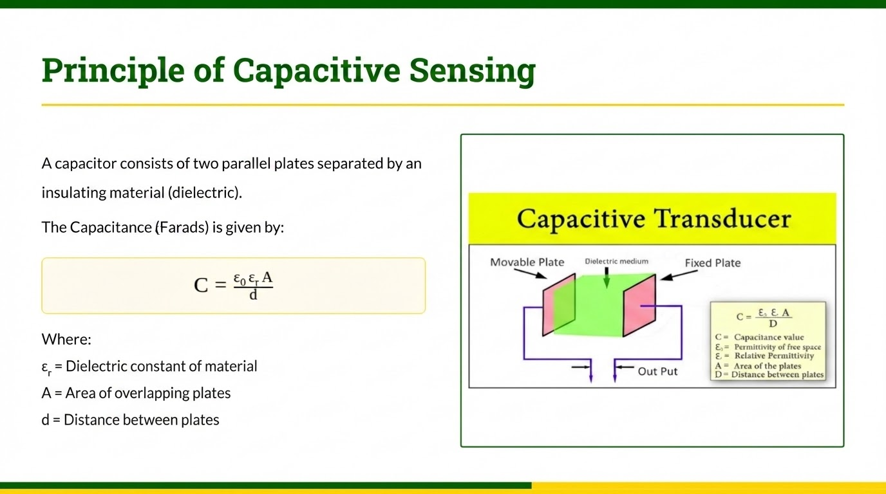

Slide 4







How we use C to Measure
By varying one of the three parameters, we can sense physical changes:
Variable Distance (d)
Variable Area (A)
Variable Dielectric (ε)
Used for measuring very small displacements, pressure (diaphragms), or sound (condenser microphones).
Used for angular displacement (rotary capacitors) or linear displacement (sliding plates).
Crucial for Agriculture: Used to measure moisture content in soil and grain.

Slide 5
Variable Distance & Area
Pressure Sensing (Variable 'd')
Liquid Level (Variable 'A' or 'ε')
A diaphragm acts as one plate. As pressure is applied, the diaphragm deflects, changing distance .
Two concentric tubes lowered into a fuel tank. As fuel rises, it changes the effective dielectric or area.
Pros: Extremely sensitive.
Ag Use: Tractor fuel gauges and chemical tank monitoring.
Cons: Non-linear (C is inversely proportional to d).

Slide 6


Variable Dielectric (ε)
The Dielectric Constant ( ) represents a material's ability to store electrical energy.
Air:
Dry Soil:
Water:
Key Insight: Since Water's ε is so much higher than soil, any increase in Capacitance is directly due to water content.

Slide 7
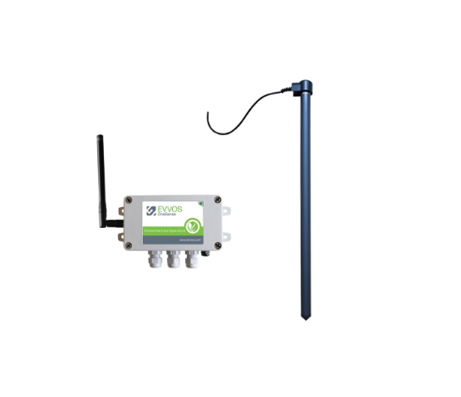
Capacitive Soil Moisture Sensors
FDR (Frequency Domain Reflectometry)
The sensor acts as a capacitor. The soil is the dielectric.
The sensor is part of an LC oscillator circuit. As soil moisture increases -> Dielectric increases -> Capacitance increases -> Frequency decreases.
We measure the frequency shift to determine Volumetric Water Content (VWC).

Slide 8







Grain Moisture Sensing
The Problem
The Solution
Challenges
Farmers need to know if maize is dry enough (e.g., < 13%) for storage to prevent aflatoxins.
Grain is poured between two metal plates. The capacitance is measured.
Density fluctuations (packing) and temperature also affect readings, requiring compensation.
Wet grain = High Capacitance.
Dry grain = Low Capacitance.

Slide 9

Part 2: Inductive Transducers
These sensors rely on the principle of electromagnetic induction.
Faraday's Law: A voltage is induced in a conductor when the magnetic field around it changes.
We typically change the Self-Inductance or Mutual Inductance by moving a magnetic core within a coil.

Slide 10

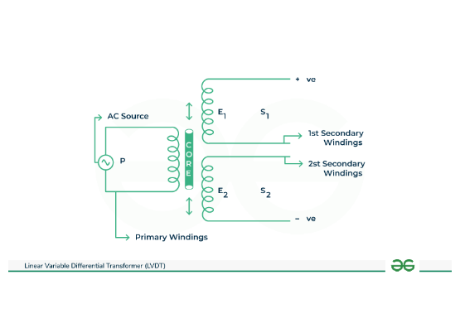
LVDT: Linear Variable Differential Transformer
The most accurate sensor for measuring linear position.
Construction
Primary Coil (P): Excited by AC voltage.
Secondary Coils (S1, S2): Two identical coils connected in series opposition.
Core: Moveable soft iron core.

Slide 11

How LVDT Works
Null Position
Move Left
Move Right
Core is centered. Voltages in S1 and S2 are equal but opposite.
Core couples more flux to S1.
Core couples more flux to S2.
V_out increases (in phase with Primary).
V_out increases (180° out of phase).
V_out = 0V

Slide 12
LVDT: Pros & Cons
Advantages
Disadvantages
Infinite Resolution: Limited only by signal conditioning.
Cost: Expensive compared to Potentiometers.
No Friction: Non-contact core means theoretically infinite life.
Complex Electronics: Requires AC excitation and demodulation (AC to DC conversion).
Rugged: Can withstand high vibration and dirty environments.

Slide 13
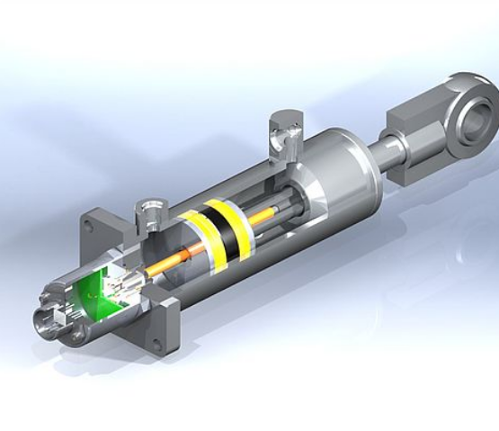
LVDT in Agriculture
Smart Cylinders
LVDTs are built inside the hydraulic cylinders of modern tractors.
Function: Precise feedback of the hitch position or steering angle.
This allows for Draft Control (maintaining constant plow depth) and GPS Auto-steering.

Slide 14

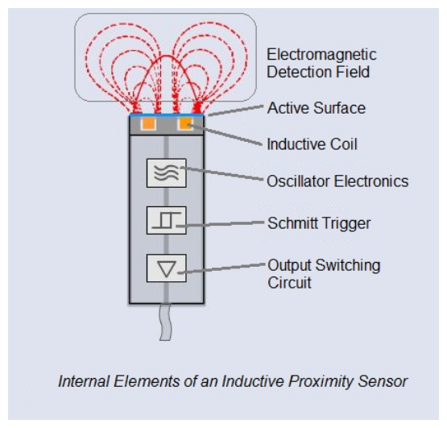
Inductive Proximity Sensors
Principle
An oscillating magnetic field is generated at the tip. When a metal object enters the field, Eddy currents are induced in the metal.
This drains energy from the oscillator, reducing the amplitude. The sensor detects this drop and switches "ON".
Ag Use: Counting shaft RPM (speed sensor), checking if a door is closed.

Slide 15
Comparison: Transducer Types
Feature | Resistive (Pot) | Capacitive | Inductive (LVDT)
Contact | Yes (Wiper wear) | No (Non-contact) | No (Non-contact)
Linearity | Good | Poor (Non-linear) | Excellent
Application | Cheap Position | Moisture / Level | Precise Position
Cost | $ | $$ | $$$

Slide 16
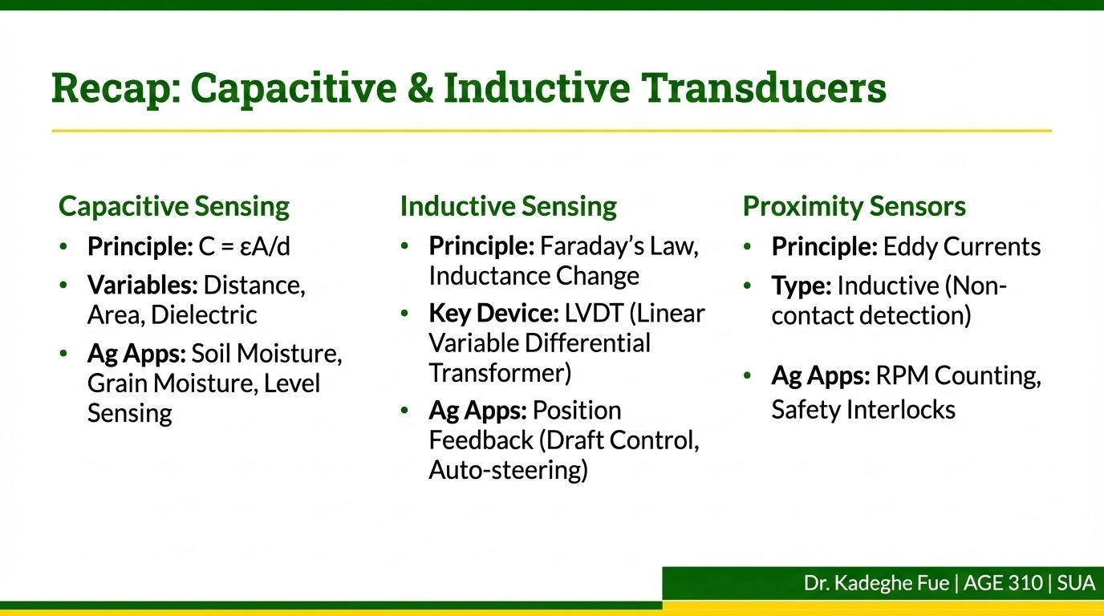

Slide 17

Discussion
End of Lecture 4
Next Class: Piezoelectric and Photoelectric Transducers.
Dr. Kadeghe Fue | AGE 310 | SUA

